Slide 1




2025
Economic Planning
and
Development Models
Presented by
Page 1
Meenukutty V
Next Slide

Slide 2

2025
INTRODUCTION
Economic Planning is the process by which a central authority (usually the government) makes major economic decisions regarding the use of resources.
It involves setting goals, allocating resources, and implementing strategies to achieve sustainable growth and development.
Particularly relevant for developing countries to guide structural transformation.
Page 2
Next Slide

Slide 3
OBJECTIVES
2025
Accelerated Economic Growth
Increase GDP and national income.
Employment Generation
Reduce unemployment through targeted programs.
Reduction of Inequalities
Promote social justice and equitable distribution.
Regional Balance
Address regional disparities in development.
Modernization of the Economy
Promote technology and industrialization.
Self-Reliance
Reduce dependence on foreign aid and imports.
Page 3
Next Slide

Slide 4
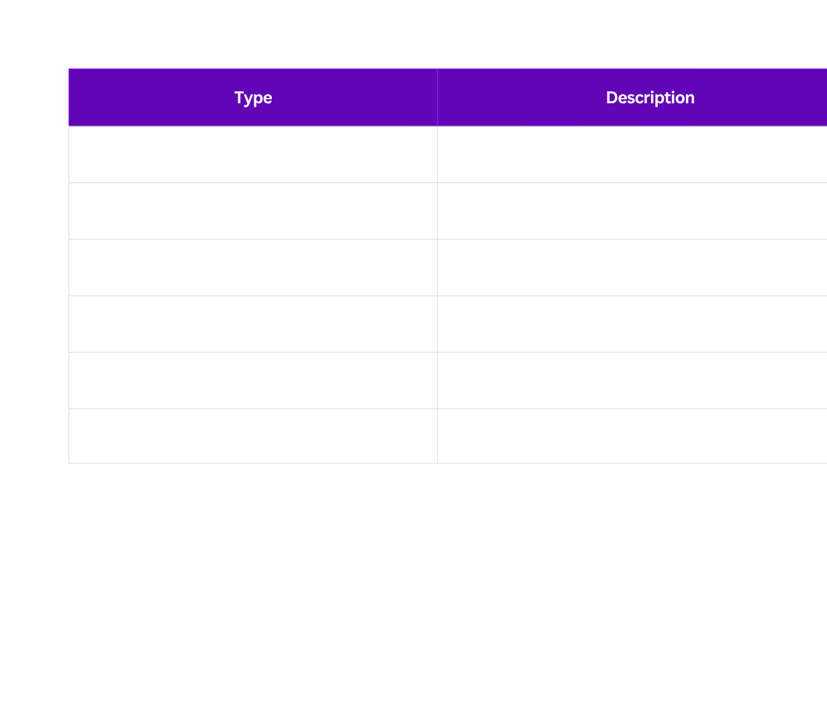
TYPES OF
2025
ECONOMIC PLANNING
Page 4
Next Slide

Slide 5

2025
DEVELOPMENT
MODELS
Economic development models explain how countries can achieve sustained growth.
Page 5
Next Slide

Slide 6

2025
HARROD–DOMAR
MODEL
Focuses on capital accumulation and savings.
Growth depends on:
Savings rate (S)
Capital-output ratio (v)
G = S / v
Limitations: Ignores technological progress and labor productivity.
Page 6
Next Slide

Slide 7

2025
LEWIS DUAL SECTOR
MODEL
Economy has two sectors:
Traditional Agricultural (surplus labor, low productivity)
Modern Industrial (high productivity)
Surplus labor shifts to industry → industrial growth.
Key Focus: Structural transformation of labor.
Page 6
Next Slide

Slide 8

2025
ROSTOW’S STAGES OF GROWTH
MODEL
Traditional Society
Preconditions for Take-off
Take-off
Drive to Maturity
Age of High Mass Consumption
Highlights linear stages of economic transformation.
Page 6
Next Slide

Slide 9

2025
MAHALANOBIS
MODEL
Applied during India’s 2nd Five-Year Plan.
Focus on heavy industry and capital goods sector.
Priority to build long-term capacity.
Page 6
Next Slide

Slide 10

2025
SOLOW–SWAN NEOCLASSICAL
MODEL
Introduces technological progress.
Predicts convergence of countries if they have similar savings and population growth rates.
Explains long-term growth through productivity improvements.
Page 6
Next Slide

Slide 11


2025
ECONOMIC PLANNING
in India
Planning Commission established in 1950.
First Five-Year Plan (1951–56): Agriculture-focused.
Second Plan (1956–61): Industrialization (Mahalanobis).
Shift toward liberalization in 1991 → indicative planning through NITI Aayog (2015 onwards).
Page 7
Next Slide

Slide 12
2025
CHALLENGES
OF
Implementation bottlenecks
Political instability and bureaucratic delays
Over-reliance on state intervention in early plans
Economic Planning
Regional and income disparities
Adapting to globalization and private sector participation
Page 8
Next Slide

Slide 13

2025
CONCLUSION
Economic planning remains essential to guide resource allocation and long-term development.
Development models provide theoretical frameworks to understand, analyze, and design policies.
A balanced mix of planning and market forces is key for modern economies.
Page 9
Next Slide

Slide 14

2025
Thank
You!
Page 15

